Slide 1
GCSE Mathematics
Problem Solving
Shape and Measure
Higher Tier

Slide 2
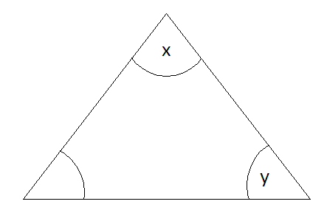


The triangle below has an area of 14cm². Calculate the possible values for the angle x and the angle y.
8cm
7cm
20°
Use the Sine rule for area to help you find the angle x.
The questions suggests their maybe more than one value for x. Use the Sin graph to help you find all the possible values for x.
(b) Use your answers in (a) to find the possible values for y.
.
Helping Hand

Slide 3
Answer
The area of the triangle
30˚ = C

Slide 4
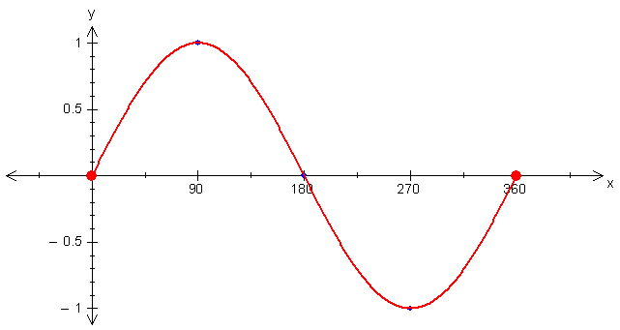
Answer
There is more than one possible answer. Use the sin graph to find the other possible value for x.
30
180 – 30 = 150
Therefore: x = 30° or 150°

Slide 5
Answer
30°
150°
8cm
7cm
8cm
7cm
or
20°
20°
Find y
If x is 30˚:
y = 180 – 30 – 20
y = 130˚
or
Find y
If x is 150˚:
y = 180 – 150– 20
y = 10˚

